Slide 1

INTRODUCTION TO DATA

Slide 2
DIFFERENCE BETWEEN DATA AND INFORMATION
DATA
INFORMATION
A raw and unorganized fact that doesn’t have
a specific meaning
Collection of data that have a logical meaning
Doesn’t depend on information
Depends on data
Doesn’t help in decision making
Helps in decision making
Example: student test score
Example: The average score of the class derived from given data

Slide 3
IS DATA USEFUL FOR US
Improve people’s lives
Make informed decisions (i.e., data=knowledge)
Get the results you want
Find solutions to problems
Be strategic in your approaches

Slide 4

BIG DATA
It is a collection of data that is huge in volume yet growing exponentially with time.
It is a combination of structured, semi structured
and unstructured data collected by organizations.
It is used in machine learning projects, predictive modelling, etc.,

Slide 5
STRUCTURED, SEMISTRUCTURED AND
UNSTRUCTURED DATA
STRUCTURED DATA : A data whose elements are addressable for effective analysis.
Here all data is stored in the form of tables.
Example: names, phone numbers, age, etc.,
SEMISTRUCTURED DATA : It is a data that doesn’t resides in a relational database.
But have some organizational properties that make it easier to Example: email, xml data, zipped files.
UNSTRUCTURED DATA : It is a data which is not organized in a predefined manner
It has no easily identifiable structure.
Example: images, videos, reports.

Slide 6
TYPES OF DATA
There are two types of data. They are quantitative data and qualitative data.
QUANTITATIVE DATA QUALITATIVE DATA
The data which can be measured in numbers.
It answers the question of how much and how many.
Example: height in cm, weight in kgs
The data which cannot be measured in numbers.
Also known as categorical data.
It answers the question of how and why.
Example: case studies, description

Slide 7
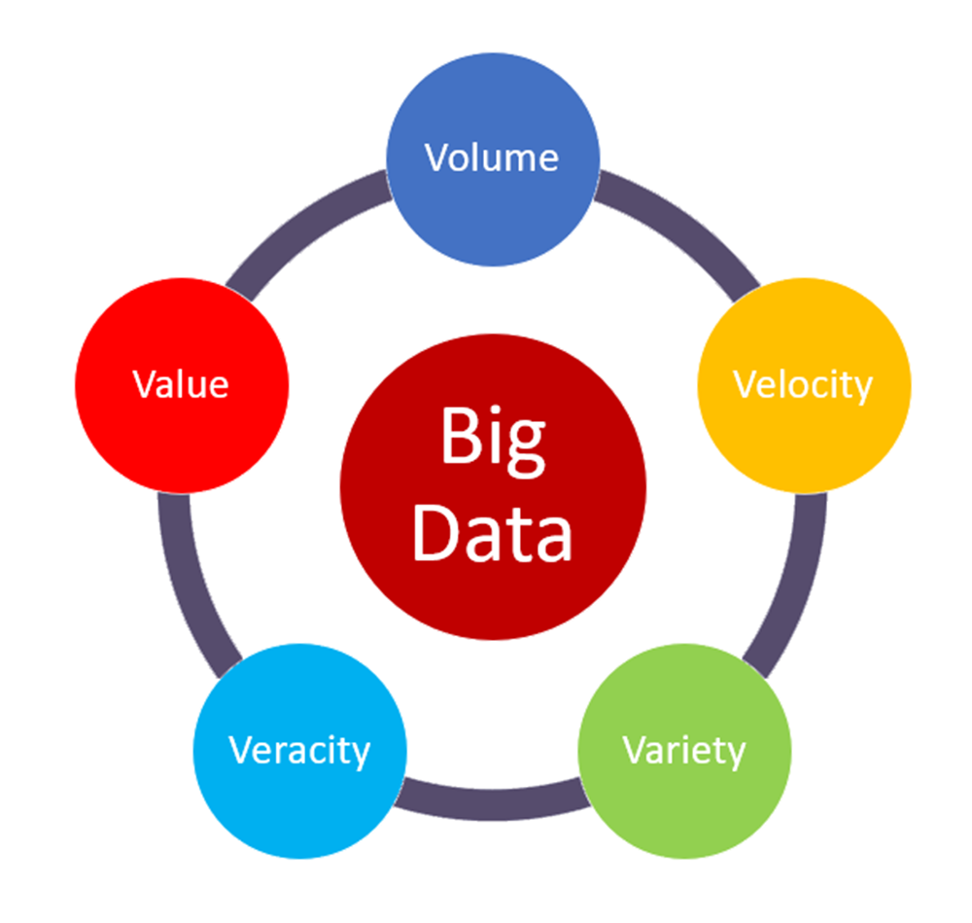
DIFFERENT V’s IN BIG DATA
VOLUME : The size and amount of big data that organizations able
to manage.
VALUE : It usually comes from insight discovery and pattern recognition.
VARIETY : The diversity and range of different datatypes.
VELOCITY : The speed at which companies receive, store and manage data.
VERACITY : The truth and accuracy of data and information assets.

Slide 8

POWERFUL TOOLS IN BIG DATA
APACHE CASSANDRA
STATWING
TABLEAU
APACHE HADOOP
MONGO DB

Slide 9
TYPES OF DATA
DISCERETE DATA
QUANTITAIVE DATA
DATA
CONTINUOUS DATA
QUALITATIVE DATA
NOMINAL DATA
CORDINAL DATA

Slide 10
TYPES OF QUANTITATIVE DATA
QUANTITATVE DATA : It is measured in numbers.
There are 2 types of it. They are discrete data and continuous data.
DISCRETE DATA : It can take only certain numerical values.
It involves integers and whole numbers rather than fraction.
Example: How many students in a class.
CONTINUOUS DATA : It can take any values and can divided into smaller parts
Example: The temperature of a human body.

Slide 11
TYPES OF QUALITATIVE DATA
QUALITATIVE DATA : It is descriptive that cannot be measured or counted. It has 3 types. They are
binary, nominal and ordinal.
BINARY : It can take exactly two possible values. Satisfies
Example: male or female, yes or no.
NOMINAL : Used to give label something without a numerical value.
Example: names of people, nationality, gender.
ORDINAL : Used for measures of satisfaction, happiness.
Example: giving ratings and reviews.

Slide 12
THANK YOU

